Slide 1
Unit 2: CPU/ Process Scheduling

Slide 2

Relate!!

Slide 3
Basic Concept
Imagine you're at a busy cafe,
Orders must be managed efficiently, ensuring prompt customer service.
Similarly, Modern operating systems rely on CPU scheduling,
optimizing task execution and resource utilization efficiently.
This effectively determines CPU task order, balancing performance, fairness, and responsiveness.

Slide 4
Basic Concept
CPU Scheduling is:
  Basis of Multi-programmed OS
Objective of Multi-programming:
  To have some processes running all the time to maximize CPU Utilization.

Slide 5
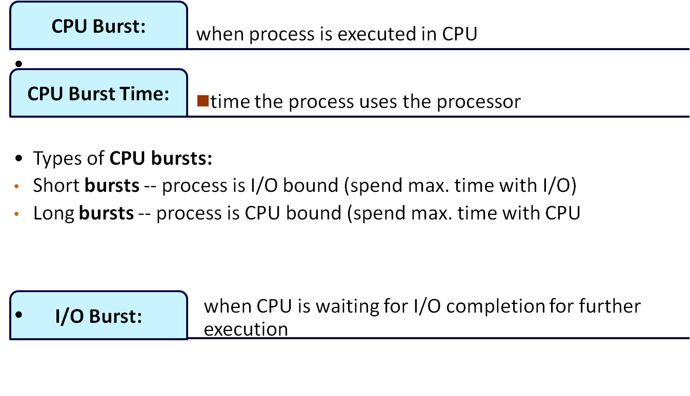
CPU and I/O Bursts

Slide 6

Sequence of CPU and I/O Bursts

Slide 7
CPU Scheduling Decisions
When process switches from Running State to Waiting State (i/o request or wait)
When process switches from Running to Ready State (interrupt)
When process switches from Waiting State to Ready State (at completion of i/o)
When a process terminates
1. Non-preemptive
2. Pre-emptive
3. Pre-emptive
4. Non-Preemptive (allow)

Slide 8

Process States

Slide 9
Scheduling
Non-Preemptive
Preemptive

Slide 10
Non-Preemptive
Once CPU is allocated to process,
process retains CPU until completion.
It may switch to a waiting state.
Example: Windows 3.x, Apple Macintosh systems.
Process executes till it finishes.
Example: First In, First Out scheduling.

Slide 11
Preemptive Scheduling
The running process is interrupted briefly.
It resumes once priority task finishes.
CPU or resources are taken away.
A high-priority process needs immediate execution.
Lower-priority processes must wait for turn.
This ensures critical tasks are completed efficiently.

Slide 12
Dispatcher
Dispatcher manages CPU control, enabling process execution.
Functions include context switching, user mode switching.
Restarts program at proper memory location.
Dispatcher must operate efficiently, minimizing delays.
Invoked during every process switch promptly.
Dispatch latency measures process-switch time duration.

Slide 13
Scheduling Criteria
Which algorithm to use in a particular situation
1. CPU Utilization: CPU should be busy to the fullest
2. Throughput: No. of processes completed per unit of time.
3. Turnaround Time: The time interval from submitting a process to the time of completion.
Turnaround Time= Time spent to get into memory + waiting in ready queue + doing I/O + executing on CPU
(It is the amount of time taken to execute a particular process)

Slide 14
Scheduling Criteria
4. Waiting Time: Time a process spends in a ready queue.
Amount of time a process has been waiting in the ready queue to acquire control on the CPU.
5. Response Time: Time from the submission of a request to the first response, Not Output
6. Load Average: It is the average number of processes residing in the ready queue waiting for their turn to get into the CPU.

Slide 15
Scheduling Algorithm Optimization Criteria
Max CPU utilization
Max throughput
Min turnaround time
Min waiting time
Min response time

Slide 16
Formula
Turn around time= Completion Time- Arrival Time
Waiting Time= Turn around Time-Burst Time
OR
Turnaround time = Burst time + Waiting time

Slide 17
First-Come, First-Served (FCFS)
Processes that request CPU first, are allocated the CPU first
It is non-preemptive scheduling algorithm
FCFS is implemented with FIFO queue.
A process is allocated the CPU according to their arrival times.

Slide 18
First-Come, First-Served (FCFS)
When process enters the ready queue,
  its PCB is attached to the Tail of queue.
When CPU is free,
  it is allocated to the process selected from Head/Front of queue.
FCFS leads to Convoy Effect

Slide 19
First-Come, First-Served (Example)
Example: Consider three processes arrive in order P1, P2, and P3.
  P1 burst time: 24
  P2 burst time: 3
  P3 burst time: 3
Draw the Gantt Chart and compute Average Waiting Time and Average Turn Around Time.
Sol:

Slide 20
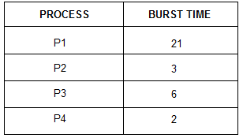
First-Come, First-Served (Example)

Slide 21
First-Come, First-Served (Example)
Calculate avg. CT, TAT, WT
Process | A T | BT | CT | TAT | WT
P1 | 0 | 2
P2 | 3 | 1
P3 | 5 | 6

Slide 22
First-Come, First-Served (Example)
Process | A T | BT | CT | TAT | WT
P1 | 0 | 4
P2 | 1 | 3
P3 | 2 | 1
P4 | 3 | 2
P5 | 4 | 5
H.W
Calculate avg. CT, TAT,WT

Slide 23
(2) Shortest Job First
Processes with least burst time (BT) are selected.
CPU assigned to process with less BT.
SJF has two types:
1. Non-Preemptive.
CPU stays until process completion only.

Slide 24
(2) Shortest Job First
2. Preemption:
New process enters the scheduling queue.
Scheduler compares execution time with current.
A shorter process preempts an already running process.
Efficient scheduling ensures minimized waiting time.

Slide 25
Shortest Job First(Preemptive)
Q1. Consider foll. Processes with A.T and B.T
Process A.T B.T
P1 0 4
P2 0 6
P3 0 4
Cal. Completion time, turn around time and avg. waiting time.
SJF(Pre-emptive)-> SRTF

Slide 26
Shortest Job First(Preemptive)
Q1. Consider foll. Processes with A.T and B.T
Process A.T B.T
P1 0 9
P2 1 4
P3 2 9
Cal. Completion time, turn around time and avg. waiting time.
SJF(Pre-emptive)-> SRTF

Slide 27
Shortest Job First(Preemptive)
Q1. Consider foll. Processes with A.T and B.T
Process A.T B.T
P1 0 5
P2 1 7
P3 3 4
Cal. Completion time, turn around time and avg. waiting time.
SJF(Pre-emptive)-> SRTF

Slide 28
Shortest Job First(Preemptive)
Q1. Consider foll. Processes with A.T and B.T
Process A.T B.T
P1 0 5
P2 1 3
P3 2 3
P4 3 1
Cal. Completion time, turn around time and avg. waiting time.

Slide 29
Shortest Job First (Non-Preemption)
  P1 burst time: 15
  P2 burst time: 8
  P3 burst time: 10
  P4 burst time: 3
  Processes arrived at the same time.

Slide 30
Practice: Shortest Job First (Non Preemption)
Q1. Consider foll. Processes with A.T and B.T
Process A.T B.T
P1 1 7
P2 2 5
P3 3 1
P4 4 2
P5 5 8
Cal. Completion time, turn around time and avg. waiting time.

Slide 31
SRTF Example
CPU idle time: (idle time/ total time spent) * 100

Slide 32
SRTF Example
Consider three processes, all arriving at time zero, with total execution time of 10, 20 and 30 units, respectively. Each process spends the first 20% of execution time doing I/O, the next 70% of time doing computation, and the last 10% of time doing I/O again. The operating system uses a shortest remaining compute time first scheduling algorithm and schedules a new process either when the running process gets blocked on I/O or when the running process finishes its compute burst. Assume that all I/O operations can be overlapped as much as possible. For what percentage of time does the CPU remain idle?
(A) 0% (B) 10.6% (C) 30.0% (D) 89.4%

Slide 33
SRTF Example
Explanation: Let three processes be p0, p1 and p2. Their execution time is 10, 20 and 30 respectively. p0 spends first 2 time units in I/O, 7 units of CPU time and finally 1 unit in I/O. p1 spends first 4 units in I/O, 14 units of CPU time and finally 2 units in I/O. p2 spends first 6 units in I/O, 21 units of CPU time and finally 3 units in I/O.
idle p0 p1 p2 idle
0 2 9 23 44 47
Total time spent = 47
Idle time = 2 + 3 = 5
Percentage of idle time = (5/47)*100 = 10.6 %

Slide 34
Priority Scheduling
Priority is associated with each process.
CPU is allocated to the process with highest priority.
If 2 processes have same priority → FCFS
Disadvantage: Starvation (Low priority Processes wait for long)
Solution of Starvation:
Aging: The priority of a process is gradually increased over time to prevent it from starving (waiting indefinitely).

Slide 35
Priority Scheduling (Preemptive)
Process | Arrival Time | Priority | Burst Time | Completion Time
P1 | 1 | 5 | 4
P2 | 2 | 7 | 2
P3 | 3 | 4 | 3
Consider 4 as Highest and 7 as Lowest Priority

Slide 36
Priority Scheduling (Preemptive)
Process | Arrival Time | Priority | Burst Time | Completion Time
P1 | 0 | 2 | 10
P2 | 2 | 1 | 5
P3 | 3 | 0 | 2
P4 | 5 | 3 | 20
Consider 0 as Lowest and 3 as Highest Priority

Slide 37
Priority Scheduling (Preemptive)
Process | Arrival Time | Priority | Burst Time | Completion Time
P1 | 0 | 2 | 10
P2 | 2 | 1 | 5
P3 | 3 | 0 | 2
P4 | 5 | 3 | 20
Consider 3 as Lowest and 0 as Highest Priority

Slide 38
Round Robin Scheduling
A Time Quantum is associated to all processes
Time Quantum: Maximum amount of time for which process can run once it is scheduled.
RR scheduling is always Pre-emptive.

Slide 39
Round Robin
TQ: 2
Process | Arrival Time | Burst Time | Completion Time
P1 | 0 | 5
P2 | 1 | 7
P3 | 2 | 1
Process | Arrival Time | Burst Time | Completion Time
P1 | 0 | 3
P2 | 3 | 4
P3 | 4 | 6

Slide 40
Round Robin
TQ: 2
Process | Arrival Time | Burst Time | Completion Time
P1 | 0 | 4
P2 | 1 | 5
P3 | 2 | 2
P4 | 3 | 1
P5 | 4 | 6
P6 | 6 | 3

Slide 41
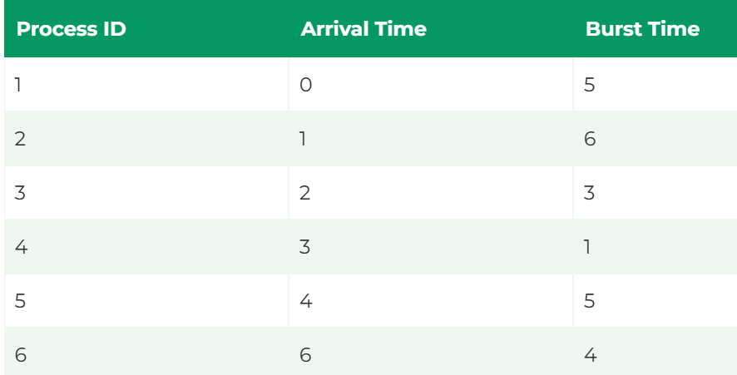
Round Robin
TQ: 4

Slide 42
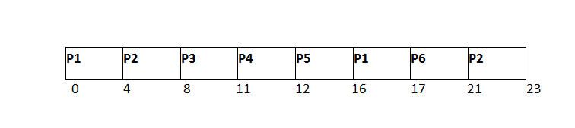
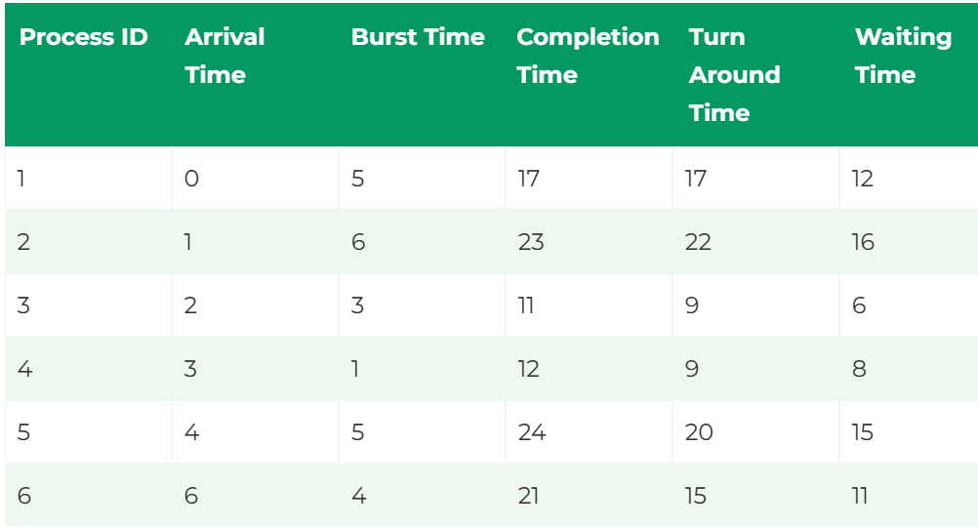
Round Robin

Slide 43
Multilevel Queue Scheduling
Partition the ready queue into several separate queues.
For Example: a multilevel queue scheduling algorithm with five queue:
1. System processes
2. Interactive processes
3. Interactive editing processes
4. Batch processes
5. Student/ user processes

Slide 44
Multilevel Queue
A process moves between various queues.
Multilevel Queue Scheduler defined by parameters.
Number of queues is defined here.
Scheduling algorithms for each queue specified.
Method determines when to upgrade process.
Method decides which queue gets service.

Slide 45
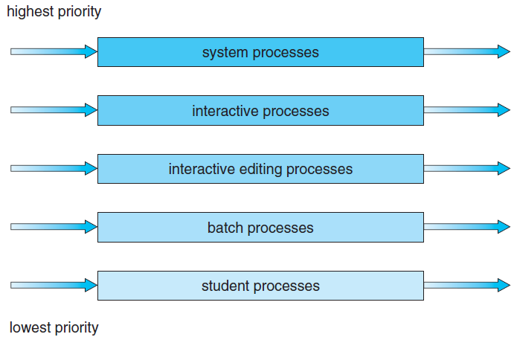
Multilevel Queue

Slide 46
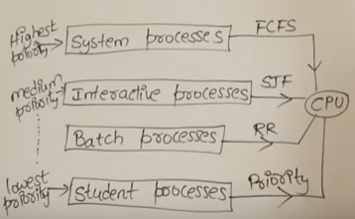
Multilevel Queue

Slide 47
Multilevel Queue
1. System Processes: These are programs that belong to OS (System Files)
2. Interactive Processes: Real-Time Processes e.g. playing games online, listening to music online, etc.
3. Batch Processes: Lots of processes are pooled and one process at a time is selected for execution. I/O by Punch Cards
4. Student/User Processes

Slide 48
Multilevel Queue
No process in the batch queue could run unless the other queues for the system were empty.
If an interactive editing process entered the ready queue while a batch process was running, the batch process would be preempted.

Slide 49
Multilevel Queue
Processes can be :
  Foreground Process: processes that are running currently
  Background Process: Processes that are running in the background but their effects are not visible to the user.
Processes are permanently assigned to one queue on some properties:
  memory size, process priority, process type.
Each queue has its own scheduling algorithm

Slide 50
Multilevel Queue
Different types of processes exist, So
Cannot apply same scheduling algorithm.
Disadvantages:
Until high priority queue is not empty,
No process from lower priority queues will be selected.
Starvation for lower priority processes.
Advantage:
Can apply separate scheduling algorithm for each queue.

Slide 51
Multilevel Feedback Queue
Solution is: Multilevel Feedback Queue
If a process is taking too long to execute..
Pre-empt it send it to low priority queue.
Don’t allow a low priority process to wait for long.
After some time move the least priority process to high priority queue → Aging

Slide 52
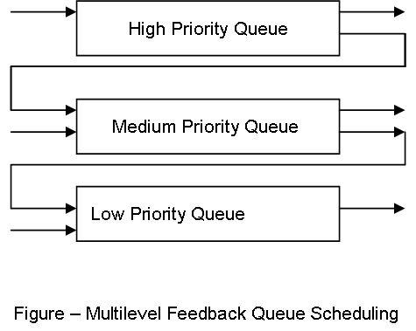
Multilevel Feedback Queue

Slide 53
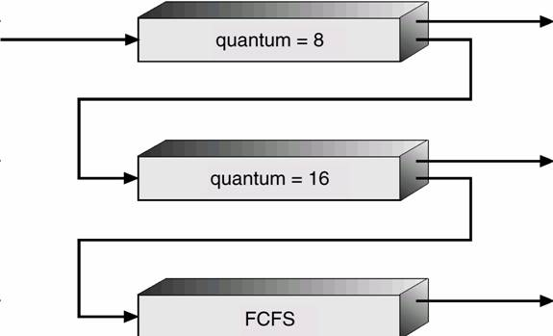
Multilevel Feedback Queue

Slide 54
Multi-processor Scheduling
Concerns:
Multiple CPUs enable load sharing.
Focus is on homogeneous processors' systems.
Use any processor for any process.
Various types of limitations exist.
Systems with I/O devices have restrictions.
Devices must run on specific processors.

Slide 55
Approaches to Multiple-Processor Scheduling
1. Asymmetric multiprocessing
Scheduling decisions, I/O processing handled by server.
Other processors execute only user code.
One processor accesses system data structures.
Reduces the need for data sharing.
Single processor controls system activities efficiently.
Improves data management, reducing conflicts.

Slide 56
Approaches to Multiple-Processor Scheduling
2. Symmetric multiprocessing (SMP)
Each processor is self-scheduling and efficient.
All processes may share a common queue.
Each processor may have a private queue.
Schedulers examine queues and select processes.
Modern operating systems widely support SMP.
Like, Windows, Linux, Mac OS X included.

Slide 57
Issues concerning SMP systems
1. Processor Affinity
(a process has an affinity for the processor on which it is currently running.)
Consider what happens to cache memory when a process has been running on a specific processor.
The data most recently accessed by the process populate
the cache for the processor.
As a result, successive memory accesses by the process are often in cache memory.

Slide 58
Issues concerning SMP systems
1. Processor Affinity
If the process migrates to another processor.
The contents of cache memory must be invalidated for the first processor,
and the cache for the second processor must be repopulated.

Slide 59
Issues concerning SMP systems
1. Processor Affinity
High cost of invalidating and repopulating caches.
Most SMP systems avoid process migration entirely.
They attempt to keep processes running consistently.
This concept is called processor affinity generally.
A process has affinity for its processor.
It runs on the same processor continuously.

Slide 60
Issues concerning SMP systems
Forms of Processor Affinity
1. Soft affinity
An OS tries keeping processes on the same processor.
This is called soft affinity policy.
2. Hard affinity
The OS tries to keep processes stable.
Processes may migrate between different processors.

Slide 61
Issues concerning SMP systems
2. Load Balancing
On SMP systems, workload balance is important.
All processors should be fully utilized efficiently.
Load balancing prevents some processors from idling.
High workloads may burden specific processors excessively.
Idle processors waste system resources and efficiency.
Balanced workloads maximize the system's overall performance.

Slide 62
Issues concerning SMP systems
2. Load Balancing
Two approaches to load balancing: push migration and pull
migration.
1. Push migration: a specific task periodically checks the
load on each processor and—if it finds an imbalance—evenly distributes the load by moving (or pushing) processes from overloaded to idle or less-busy processors.
2. Pull migration: occurs when an idle processor pulls a waiting task from a busy processor.

Slide 63
Issues concerning SMP systems
3. Multicore Processors
A multi-core processor has independent cores.
It reads and executes program instructions.
A CPU may contain multiple cores.
A core includes registers and cache.
Core handles processor tasks, not entire.
It's essential for efficient task performance.

Slide 64
Issues concerning SMP systems
3. Multicore Processors
Multicore processors may complicate scheduling issues:
When a processor accesses memory, it spends a significant amount of time waiting for the data to become available. This situation, known as a memory stall.
Memory Stall may occur due to a cache miss (accessing data that are not in cache memory).

Slide 65
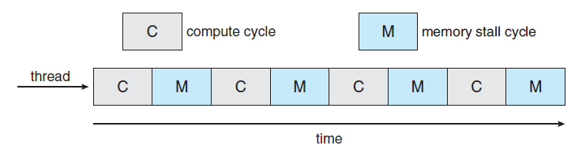
Issues concerning SMP systems
Memory Stall
the processor can spend up to 50 percent of its time waiting for data to become available from memory.

Slide 66
Real Time Scheduling
Analysis and testing of the scheduler system and the algorithms used in real-time applications
a) soft real-time systems b) hard real-time systems
Soft real-time systems provide no guarantee as to when a critical real-time process will be scheduled.
Hard real-time systems have stricter requirements. A task must be serviced by its deadline;

Slide 67
Rate-Monotonic Scheduling
Rate-monotonic scheduling assigns tasks' priorities statically.
It uses a preemption-based scheduling policy efficiently.
RMS operates in real-time operating systems seamlessly.
Static priorities depend on task cycle duration.
Shorter cycles lead to higher job priority.
This ensures periodic tasks are scheduled optimally.

Slide 68
Rate-Monotonic Scheduling
rate-monotonic scheduling assumes that the processing time of
a periodic process is the same for each CPU burst.
For example
Consider P1, P2 with time period 50,100 resp. and B.T 20,35 resp.
Cal. CPU utilization of each process and total CPU utilization.
Sol:
CPU utilization=(Burst time/Time period)= (Ti/Pi)
For P1: (20/50)=0.40 i.e 40%
For P2: (35/100)=0.35 i.e 35%
Total CPU utilization is 75%

Slide 69
Earliest Deadline First Scheduling
Earliest-deadline-first (EDF) scheduling dynamically assigns priorities according to deadline.
The earlier the deadline, the higher the priority the later the
deadline, the lower the priority.
Under the EDF policy, when a process becomes runnable, it must announce its deadline requirements to the system.

Slide 70

QUIZ FOR UNIT 2

Slide 71

Practice MCQ:

